Slide 1

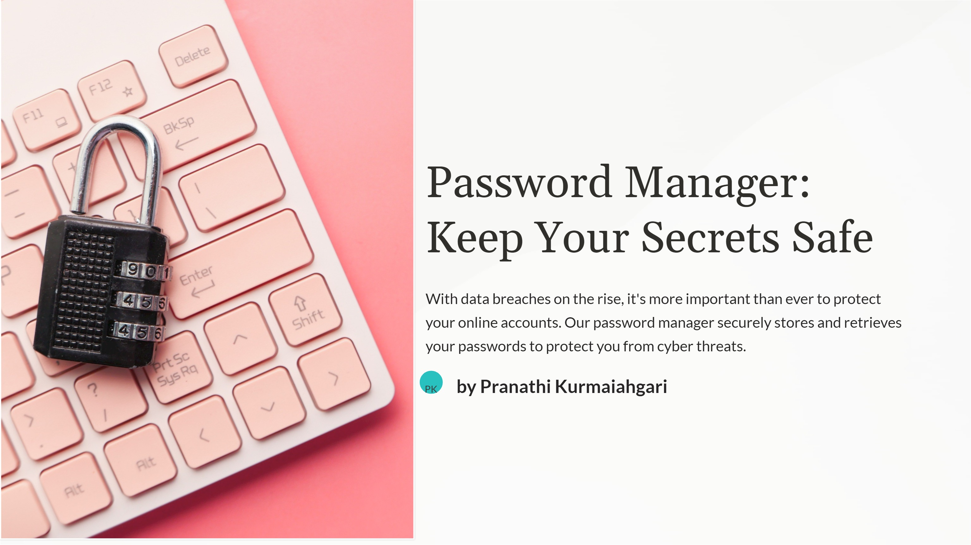

Slide 2
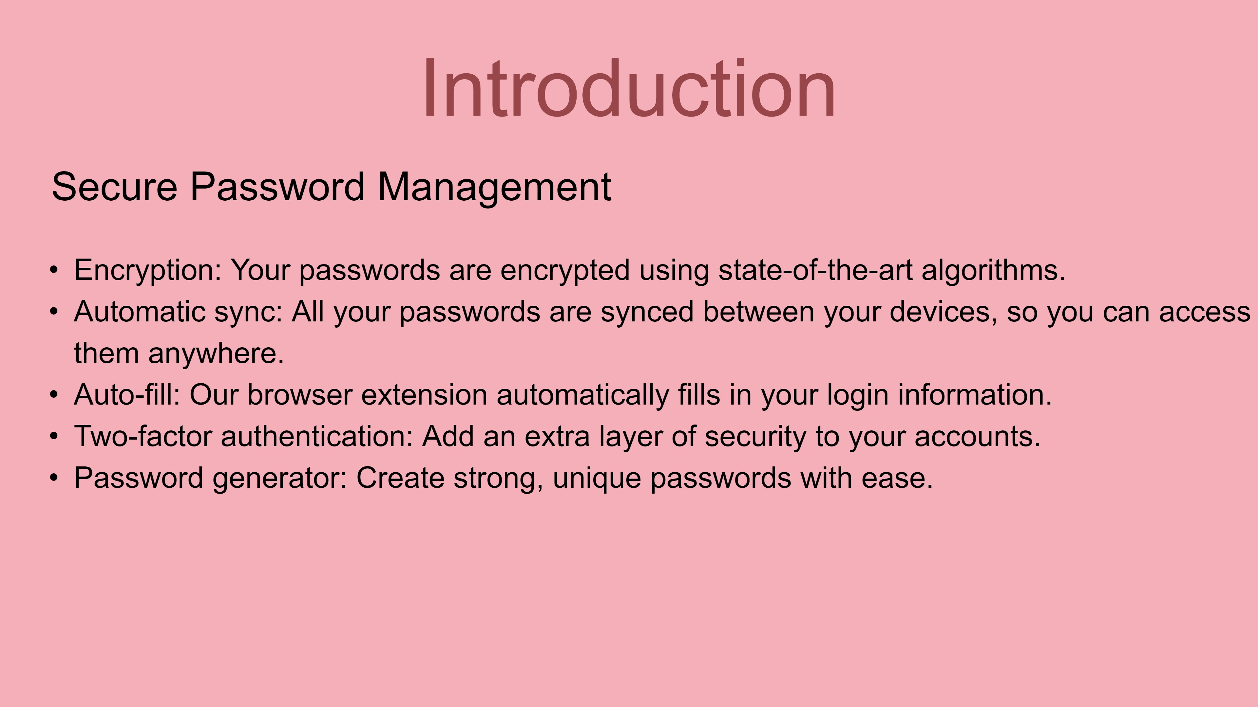

Slide 3


How It Works
Encryption
Auto-Fill
Our password manager uses end-to-end encryption to keep your data safe by preventing unauthorized access.
Our tool makes it easy to fill in login forms on websites, without having to remember each password.
Multi-Device Sync
Two-Factor Authentication
Your passwords stay synced on all your devices via the cloud, so you can always access them when you need to.
Add an extra layer of security with two-factor authentication to keep hackers at bay.

Slide 4

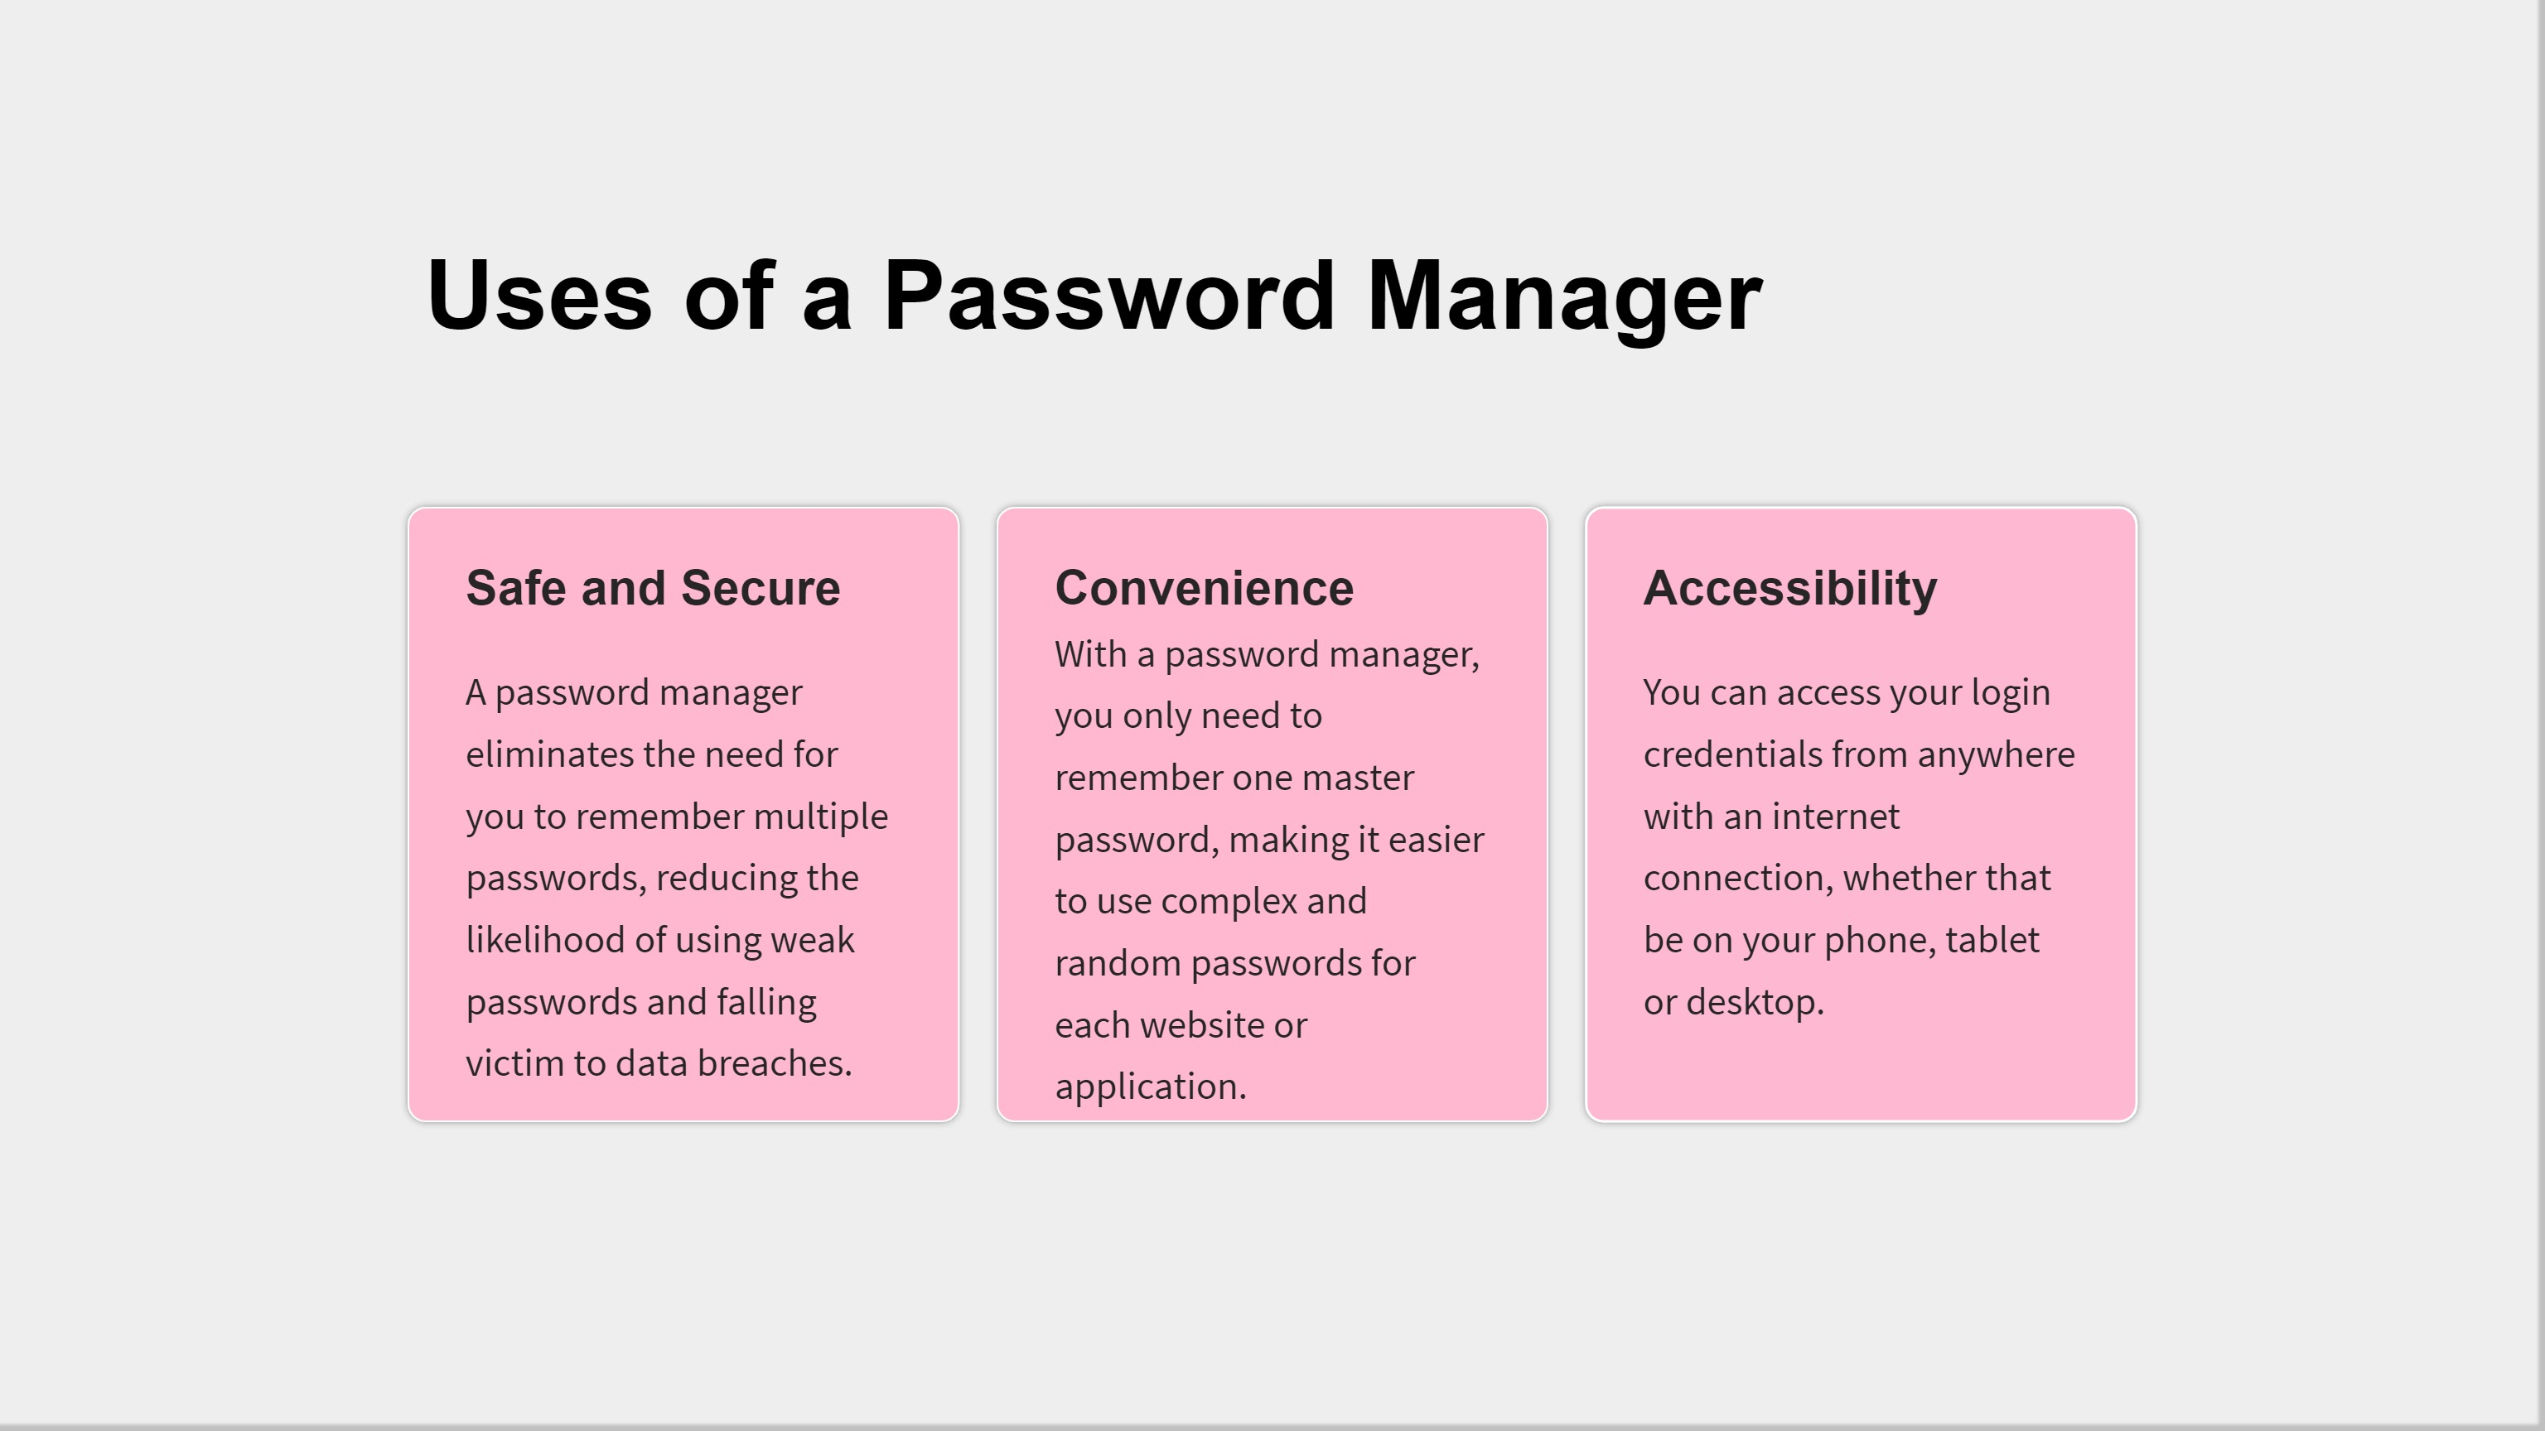

Slide 5
Advantages and Disadvantages
Advantages ✅
Disadvantages ❌
Easy to use and configure
Relies on encryption
A single master password to remember
Presents a single point of failure
Saves time
Need for constant updates
Prevents weak passwords
Requires cloud backup
Protects against phishing attacks

Slide 6
Future Scope
1
Biometric Authentication
We are planning to add fingerprint and facial recognition for extra security.
Password Strength Indicator
2
Our team is working on an algorithm that can suggest stronger passwords and grade the strength of your current passwords.
3
Dark Web Monitoring
We will introduce a tool to scan the dark web to see if your passwords have been compromised.

Slide 7
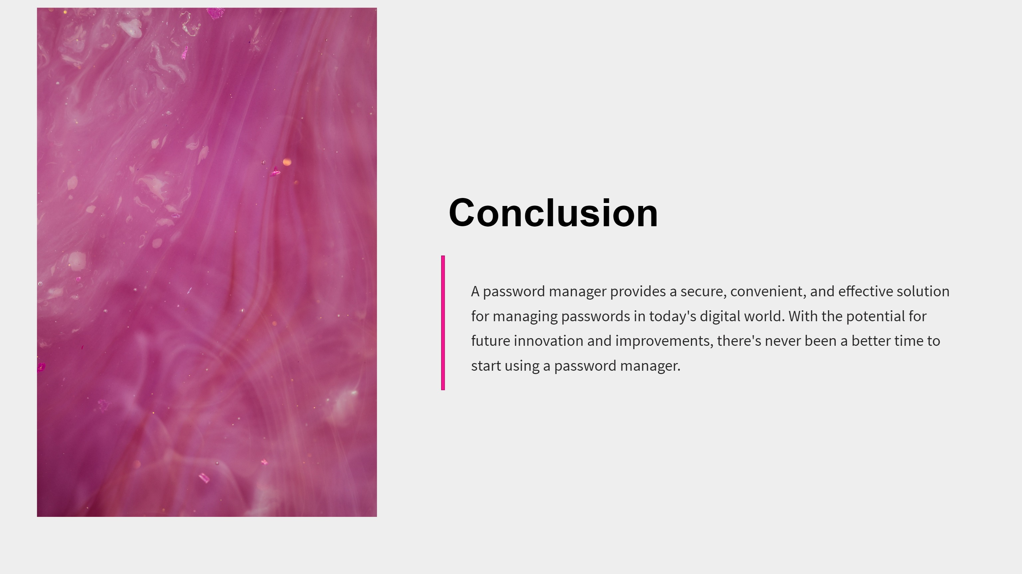

Slide 8
- C h a r l e s M a l i k
Thank You
The women of the world.

Slide 9

Thank you for your attention

